Slide 1
Learning from Incident Tool
User Manual

Slide 2
Introduction and setup
The following document is a step by step user manual for the tool to accompany the Marine Technological Society TECHOP_GEN_03 (Conducting Effective and Comprehensive DP Incident Investigations) dated Sep 2015.
The tool contains two files which should be placed in the same folder:
MTS LFI Tool.xlsm
LFI.docm
The user only needs to enter information in the “MTS LFI Tool.xlsm” document and can ignore the LFI.docm file after positioning it in the same folder.
Collect all documents that have been / will be used for the incident investigation and put them all in the same folder as the LFI tool files.
Open “MTS LFI Tool.xlsm”, thereafter enable all macros and any other permissions that pop up.

Slide 3
Tool screenshot

Slide 4
Legend
The tool follows the fishbone analysis methodology as explained in the Techop.
The user can click on to access the Techop itself and should do this as a first step if it has not been done before.
The incident elements have been differentiated into Design, Operations, People and Process factors.
Incident data is to be used to include all the supporting documentation collected and utilised during the incident investigation.
The bottom of the fishbone contains the sieved causal and contributory factors that have been identified during the incident investigation process.

Slide 5
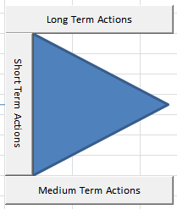
Legend
The LFI tab is to be used after all causal and contributory factors have been sieved through.
Once the LFI is complete, the fish head can be used to quickly reach the identified Long term, medium term and short term remedial actions.

Slide 6
Procedure – Incident Data

Slide 7
Procedure – Incident Data
The previous slide shows the LFI tab.
A comprehensive list is provided to identify the type of documents that may be required to assist in the incident investigation.
Click on the “Link to attachment” cell in the row of the relevant document and find the file in the LFI folder. Thereafter click okay and fill in the description cell.
Do this for all supporting documentation.
Once complete, go back to fishbone .
It is always possible to access this tab from the main fishbone.

Slide 8
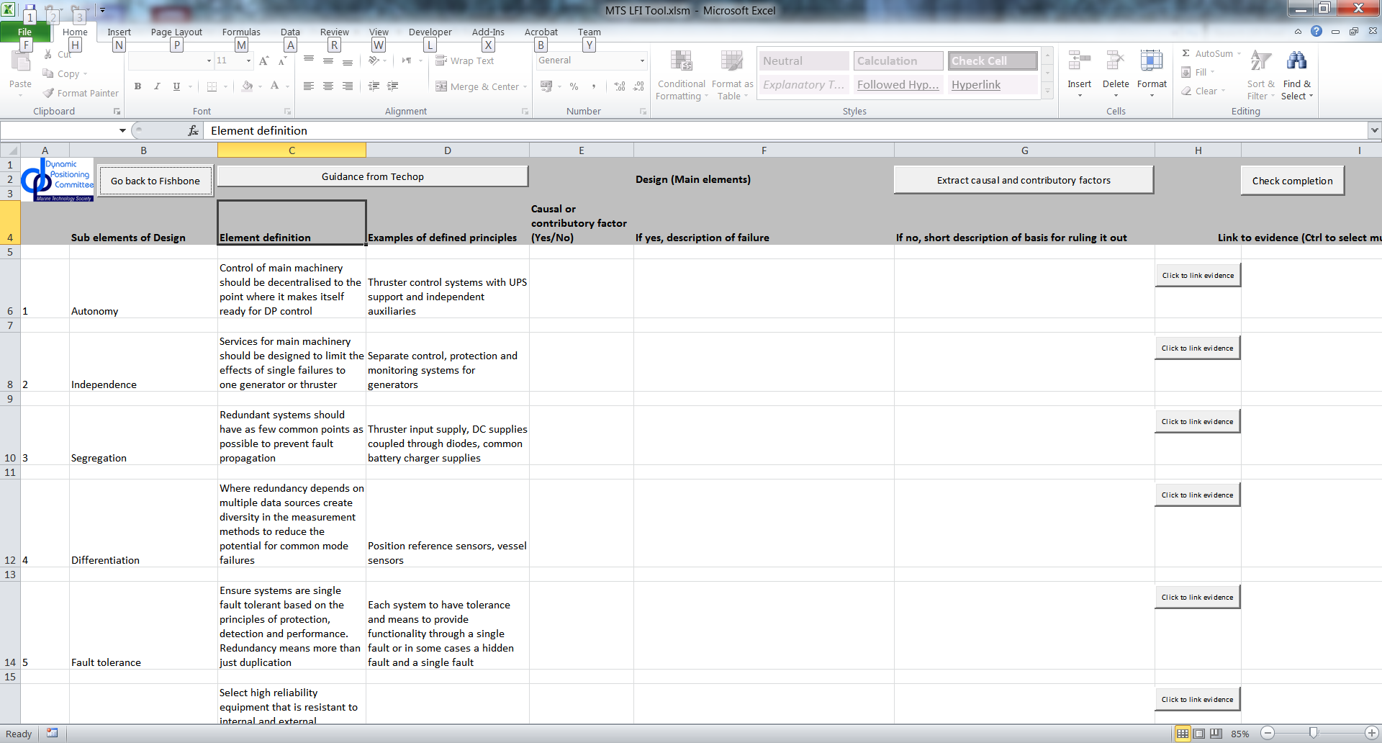
Procedure – Data analysis (Example Design)

Slide 9
Procedure – Data analysis (Example Design)
Check the sub element, definition and example to analyse whether it was a causal or contributory factor.
Check yes / no depending on the analysis. If yes, give a description of why and how it was a causal or contributory factor to the failure. If no, provide a short description of why it was ruled out.
Click and select the names of evidentiary documentation using ctrl to select multiple cells and press OK. (Leaving it blank or cancelling will lead to an error, end it and continue as normal)
Click to check how much of the analysis is to be completed. If the check says that the analysis is complete, click to sieve the causal and contributory factors to the bottom of the fish bone.
Once complete, go back to fishbone .
Perform the above steps for all the data analysis elements. (Operations, People and Process)

Slide 10
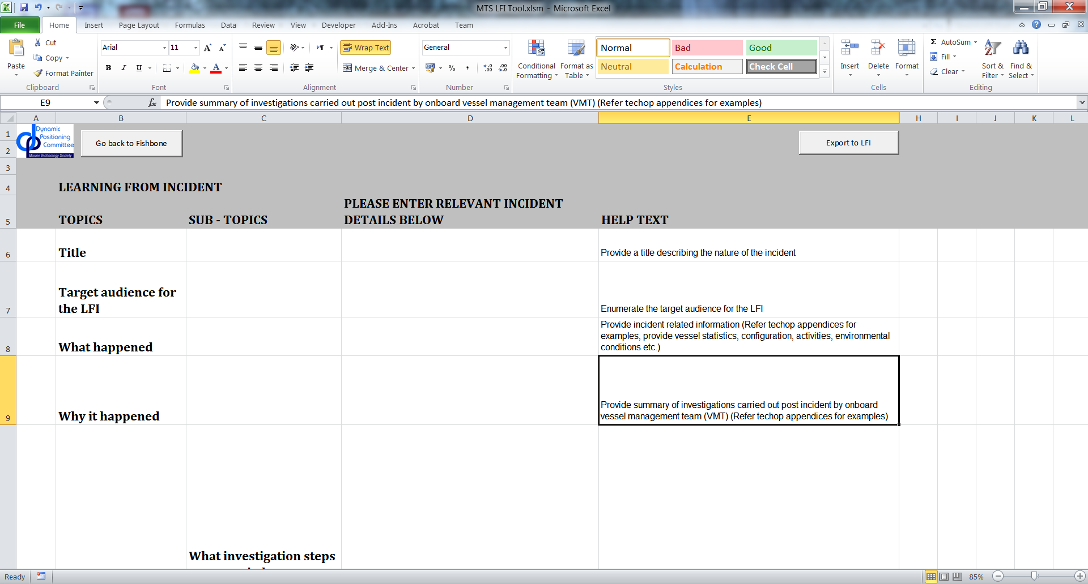
LFI Completion - LFI

Slide 11
LFI Completion - LFI
Fill in the “Please Enter Relevant Incident Details Below” cells for each topic and sub topic using the help text.
Thereafter click to create a word version of the completed LFI. If any topics have been missed, an error box will pop up and the LFI will not be created.
The word document is automatically saved as “ExportedLFI.docm” in the same folder. The completed tool is published as “Completed Incident Report.pdf”.
Note: Please be advised that the word and pdf documents, once created, are separate entities and changes made to them are not reflected back in the main excel tool. Any changes to the analysis should be made in LFI excel tool and the LFI should be exported again to reflect these changes.
The word document may be formatted to enhance presentation before submission.

